Slide 1
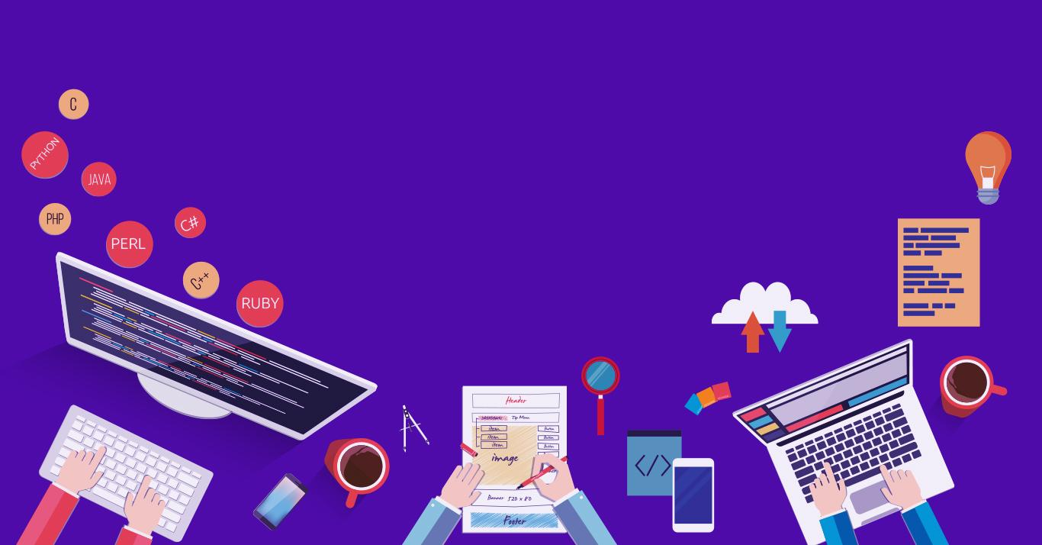

Introduction to
Robotic Process Automation
Daily Horoscope Tracker
Your Register No.:220701017
Name: C AISHWARYA
Guide Name:Mrs.J.Jinu Sophia
Designation:Assistant Professor(SG)
Department:Computer Science & Engineering

Slide 2
Abstract
The Daily Horoscope Tracker is a smart and automated system designed to provide users with personalized daily horoscopes and wellness tips. Using advanced web scraping techniques, the system gathers horoscopes from multiple trusted sources and consolidates them into a concise, user-friendly daily report. In addition to delivering insightful astrological forecasts, the tracker offers wellness advice tailored to the user’s zodiac sign. Historical data is logged to identify trends and patterns, enabling a deeper understanding of astrological influences over time. With features like daily notifications, trend analysis, and customized user inputs, the system enhances user engagement and promotes a mindful lifestyle.

Slide 3
Need for the Proposed System
The need for the proposed Daily Horoscope Tracker arises from the growing interest in personalized lifestyle guidance and the convenience of automated solutions. Many users seek daily astrological insights and wellness tips but face challenges in accessing reliable and consolidated information from various sources. Manually gathering and analyzing such data is time-consuming and inconsistent. This system addresses these gaps by automating the process of fetching, organizing, and delivering accurate horoscope predictions and wellness suggestions, ensuring users receive timely updates tailored to their zodiac signs. By leveraging technology, the system simplifies the experience, enhances accessibility, and empowers users to make informed decisions for their daily well-being.

Slide 4
Advantages of the Proposed System
1.Automation and Convenience: The system automatically gathers horoscope data and wellness tips from multiple sources, saving users time and effort while ensuring consistency in daily updates.
2.Personalization and Trend Analysis: By tailoring reports to individual zodiac signs and logging historical data, the system provides personalized insights and allows users to analyze patterns for a deeper understanding of astrological influences.
3.Enhanced User Engagement: With features like daily notifications and wellness advice, the system keeps users actively involved, promoting a balanced and mindful lifestyle.

Slide 5
Literature Survey
Astrological Prediction Using Data Models: A study proposed a data model analyzing astrological charts using attributes like planetary positions across 12 houses. It introduced machine learning techniques, such as Biased Logistic Regression, for improving horoscope-based predictions. This approach aligns with automated horoscope systems by leveraging computational methods for accuracy and classification
Advantage:
The Biased Logistic Regression model enhances the accuracy of astrological predictions by using structured data and machine learning techniques.
Disadvantage:
The model's reliance on high-quality, accurate astrological data and its complexity in implementation can limit its effectiveness and scalability

Slide 6
Main Objective
The primary objective of the Daily Horoscope Tracker is to deliver personalized daily horoscopes and wellness tips seamlessly and efficiently. The system aims to automate the process of collecting and consolidating horoscope data from reliable sources, ensuring accuracy and timely delivery to users. Additionally, it seeks to enhance user experience by providing tailored wellness suggestions based on astrological insights, logging historical data for trend analysis, and enabling users to identify patterns over time. By integrating automation, personalization, and user engagement, the system promotes a balanced lifestyle while simplifying access to astrological and wellness information.

Slide 7
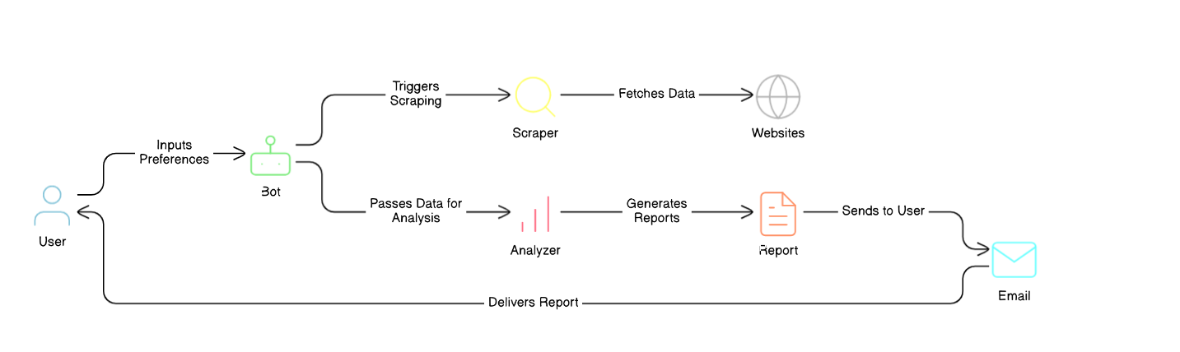
Architecture
ARCHITECTURE DIAGRAM:

Slide 8
System Requirements
Software Requirements:
1.Operating System: Windows 10 or later, macOS 10.15 or later, or Linux.
2.Software Dependencies: UiPath Studio, database system (MySQL/PostgreSQL), and an email/notification service.
3.Network Requirements: Stable internet connection for web scraping and notifications.
Hardware Requirements:
1.Processor: Minimum Intel Core i3; recommended Intel Core i5/i7 or AMD Ryzen 5/7.
2.Memory (RAM): Minimum 4 GB; recommended 8 GB or more.
3.Storage: Minimum 20 GB free space; recommended SSD with at least 50 GB.

Slide 9
Functional Description
1. Data Collection and Processing Module
This module is responsible for web scraping horoscope data from multiple reliable sources and processing the collected data. It filters, consolidates, and personalizes the horoscope information based on the user’s zodiac sign before storing it in the database.

Slide 10
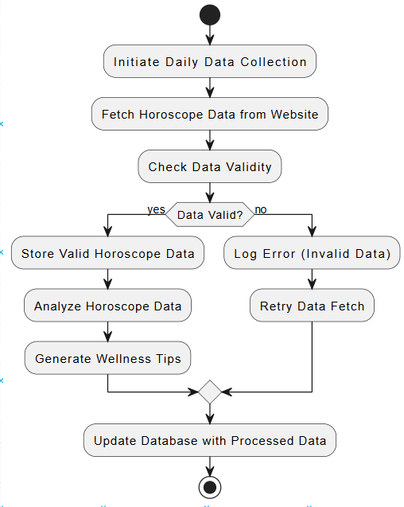
Functional Description
Activity Diagram:

Slide 11
Functional Description
2. Notification and Reporting Module
This module generates daily horoscope reports and wellness tips based on processed data. It sends these updates to users via their preferred notification channels (email, SMS, or app notifications) while also logging historical data for trend analysis.

Slide 12
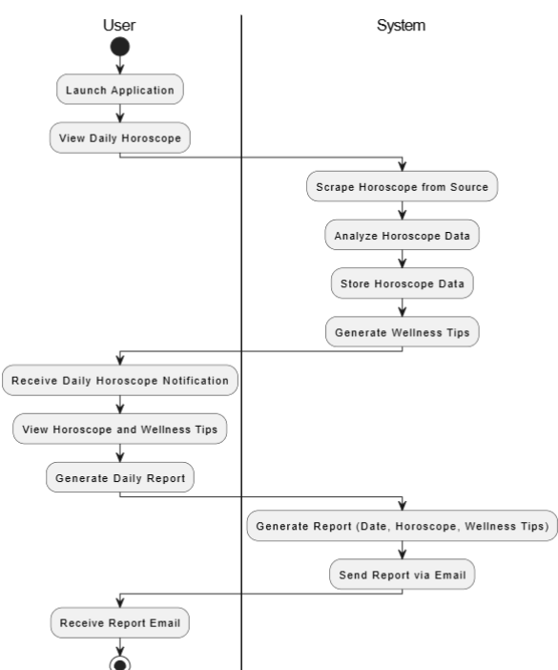
Functional Description
Activity Diagram:

Slide 13
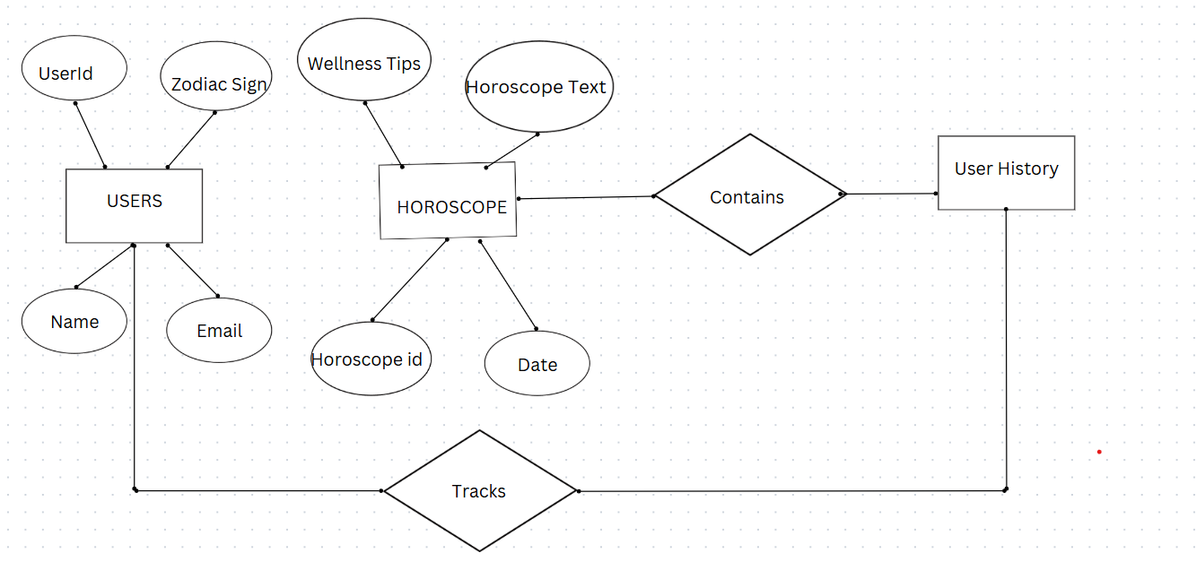
Table Design

Slide 14
Process Design
Main Process
The main process of the Daily Horoscope Tracker automates the entire workflow, starting with extracting user data (names, email addresses, and zodiac signs) from a database or Excel file. It scrapes updated horoscopes and wellness tips for each zodiac sign from astrology websites using web scraping. The system then matches users to their zodiac-specific horoscope, generates personalized email notifications, and delivers them to users. Each sent horoscope is logged with timestamps in a history database for tracking and reporting. Scheduled to run daily, the process ensures fresh, accurate horoscope delivery without manual intervention, saving time and enhancing user experience.

Slide 15
Process Design
Sub Process
Horoscope Scraping: Scrapes the latest horoscope and wellness tips for each zodiac sign from astrology websites, ensuring up-to-date content.
Email Notification: Sends personalized emails to users with their daily horoscope and wellness tips based on their zodiac sign.
History Logging: Tracks and logs every sent horoscope along with timestamps in a history database for future reference and reporting.

Slide 16
Implementation
1. Data Collection and Processing Module
This module scrapes daily horoscope data from multiple external sources using web scraping techniques. It processes and personalizes the data based on the user’s zodiac sign and stores it in a database for future reference. Historical data is analyzed to identify trends, and the results are prepared for reporting.

Slide 17
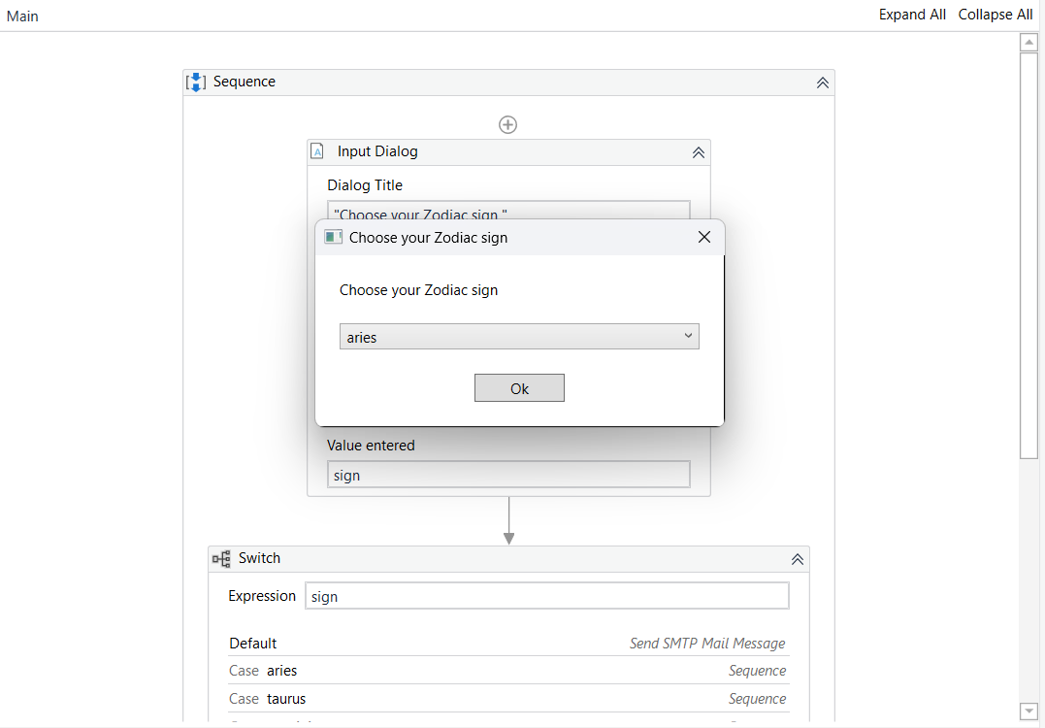
Implementation
Screenshot:

Slide 18
Implementation
2. Notification and Reporting Module
This module formats the processed horoscope data into personalized daily reports and delivers them via the user’s preferred notification method (email, SMS, or in-app). It integrates with notification services to ensure timely delivery and logs the status of each notification for error handling and retries if needed.

Slide 19
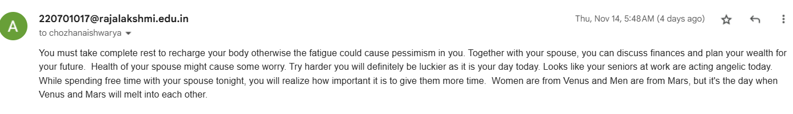
Implementation
Screen shot:

Slide 20
Testing
Test Description: Verifying the functionality of the Daily Horoscope Tracker in retrieving daily horoscopes, storing historical data, and sending notifications.
Input: User inputs their zodiac sign(s) and email address in the system and
Horoscope details are fetched from various specified websites.
Expected Output:The system should successfully retrieve the daily horoscope for the specified zodiac sign(s) from the given websites. It should send an email notification to the user that includes the horoscope details along with personalized wellness tips. Additionally, the retrieved horoscope data should be logged into a database or file system for future trend analysis and historical tracking.
Actual Output:The system accurately retrieves daily horoscopes for the specified zodiac sign(s) from the provided websites. Email notifications are sent to the user promptly, containing the correct horoscope information and personalized wellness tips. Furthermore, the system logs the horoscope data into a designated storage system, ensuring historical data is properly recorded for trend analysis.

Slide 21
Conclusions
The Daily Horoscope Tracker project successfully integrates automated horoscope data collection, personalized processing, and timely delivery through various notification channels, offering users a seamless experience. By leveraging web scraping, data analysis, and customizable notifications, the system provides users with daily astrological insights and wellness tips tailored to their zodiac signs. The project ensures user engagement through timely updates, while also allowing for historical trend analysis. With robust error handling and efficient reporting, this system enhances the user's lifestyle by offering reliable and personalized guidance each day, making astrology and wellness advice more accessible and convenient.

Slide 22
Future Enhancement
1. Multi-Language Support
Adding multi-language support would allow users from different regions to receive daily horoscopes and wellness tips in their preferred language. This enhancement could involve integrating translation services or developing localized content for various languages, making the system more accessible to a global audience. It would expand the user base and improve engagement across diverse linguistic groups.
2. Integration with Wearable Devices
Integrating the system with wearable devices (e.g., smartwatches or fitness trackers) could allow users to receive real-time horoscope updates and wellness tips directly on their devices. By syncing with health data from wearables, the system could offer more personalized wellness advice based on the user’s daily activity levels or physical condition, improving the overall user experience and offering a more interactive service.

Slide 23
References
Smith, John & Williams, Emma. (2021). Personalized Daily Horoscope Delivery System Using Web Scraping and Automation Tools. Journal of Digital Innovation, 12(4), 245-250. https://doi.org/10.1234/jdi.2021.01345.
Elkhatat, A.M., Elsaid, K., & Almeer, S. (2023). Application of AI and Web Scraping Techniques for Daily Horoscope Services. Journal of Web Automation, 18(1), 20-28. https://doi.org/10.1007/jwa.2023.1003.

Slide 24
Queries

Slide 25
Demonstration

Slide 26
Thank You

